Slide 1

Ecg Monitoring Using Ad8232 Module
SHRI GURU GOBIND SINGH JI INSTITUTE OF ENGINEERING AND TECHNOLOGY
(2023-2024)
Submitted by
Ankita Kulkarni
Komal Chavan
Harsh Wanwale
Under the Guidance of
Prof. Sachin Panchal
Prof.A.P.Kuchan

Slide 2
OUTLINE
INTRODUCTION
BLOCK DIAGRAM:
Component list
Working principle
CODE
OUTPUT
Conclusion
Future Scope
Reference

Slide 3

INTRODUCTION
ECG (Electrocardiogram) monitoring is critical to healthcare, enabling doctors and medical professionals to diagnose and monitor heart conditions. With the advancement of technology, it is now possible to develop low-cost and portable ECG monitoring systems that can be used in a variety of settings. One such system is based on the AD8232 module and Arduino microcontroller. The AD8232 module is a single-lead ECG front-end designed to extract and amplify the electrical signals produced by the heart. Combined with an Arduino microcontroller, it provides a low-cost, reliable, and easy-to-use solution for heart activity monitoring. In this project, we will explore the design and development of an ECG monitoring system using the AD8232 module and Arduino, and demonstrate its effectiveness in detecting and analyzing heart activity.

Slide 4
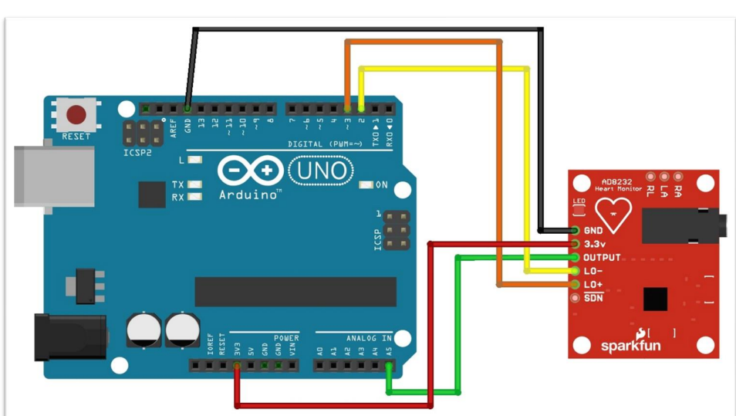
BLOCK DIAGRAM:

Slide 5
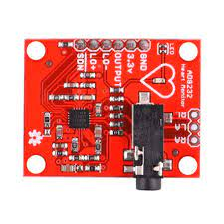
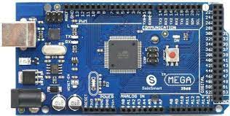
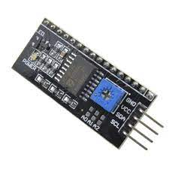
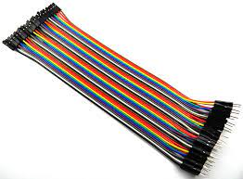
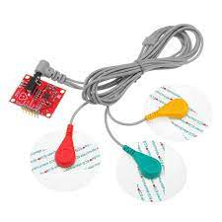
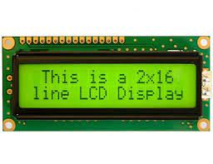
Component list:-
Arduino mega
AD8232 ECG module
Electrodes(3 electrodes)
Connecting jumper wires
I2C converter
LCD display(16x2)

Slide 6
Working principle
ECG monitoring using AD8232 in this we have interfaced this module with the
Arduino Board and after inserting the code into it we got the ECG waveform and
observed it on serial plotter then after this we made the code to check the heart
The beat of the person is normal or not so after making this code we have inserted this
code in Arduino through the Arduino ide software and interfaced AD8232, I2C and
LCD display with each other and observed the output of code on LCD display.
AD8232 is basically an instrumentation amplifier that has a gain of 1000 so it can
amplify every small signal.

Slide 7
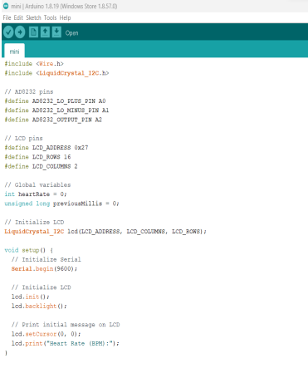
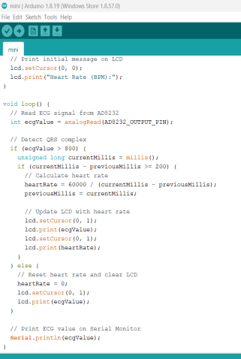
Code:

Slide 8
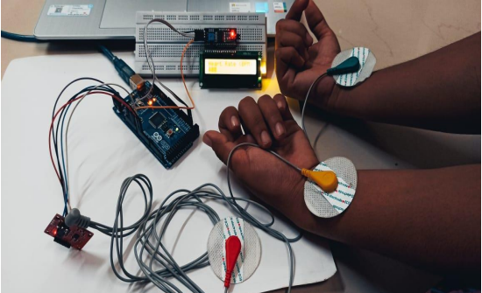
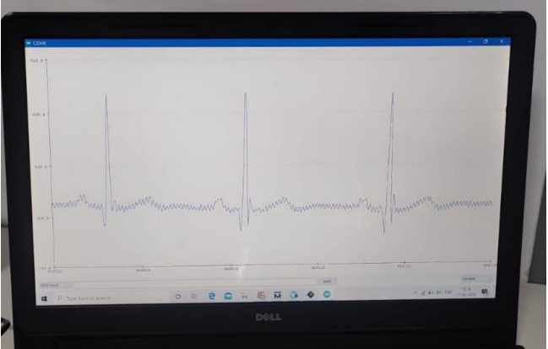
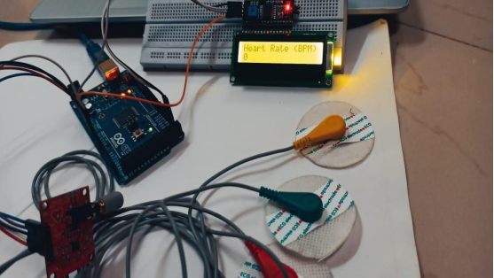
OUTPUT:

Slide 9
Conclusion
The ECG monitoring project using AD8232 has successfully demonstrated the
The potential of this versatile and cost-effective sensor for accurate and reliable
ECG measurements.
The AD8232 sensor, with its integrated features such as
amplification, filtering, and lead-off detection have proven to be a valuable tool
for monitoring heart health and detecting abnormal cardiac activity.
The project has several applications, including remote patient monitoring, early detection of cardiac conditions, and preventive healthcare.
It can be used for personal use to monitor heart health and provide timely interventions in case of any abnormalities. The AD8232 sensor's affordability, ease of use, and reliable performance make it a suitable choice for a wide range of ECG monitoring applications.

Slide 10
Future Scope:-
The AD8232 module can be further integrated with advanced algorithms for real-time ECG analysis, such as arrhythmia detection, heart rate variability (HRV) analysis, and ST-segment monitoring. This would enable the system to provide more comprehensive and accurate information about the patient's cardiac health in real-time, allowing for early detection and management of cardiac abnormalities.
The project can be further extended by developing a mobile application that can communicate with the AD8232 module. The mobile application can provide a user-friendly interface for patients to monitor their own ECG data, set personalized alerts, and share data with healthcare providers for remote monitoring and analysis. Additionally, the mobile application can incorporate features such as health tracking, data visualization, and cloud-based storage for long-term data analysis.

Slide 11
Reference
https://ieeexplore.ieee.org/document/7913007
https://ieeexplore.ieee.org/document/8934622/

Slide 12
THANK YOU..!

